Slide 1
Vulnerabilities Introduction
Power Sector Resilience Planning Guidebook
The following slides are intended to provide additional background information and examples of power system vulnerabilities. They can serve simply as a reference or can be used in local power sector resilience assessment workshops. For questions or more information on the slides, use the “Ask An Expert” feature on the Resilient Energy Platform website.

Slide 2
Key Messages
Power sector vulnerabilities usually fit into two categories:
Infrastructure
Process (and systems)
Both types of vulnerabilities need to be considered when assessing resilience options for the power sector.
Infrastructure vulnerabilities are often easy to address but tend to be very expensive.
Power system hardening
Large infrastructure development
Process vulnerabilities tend to be difficult to address but usually require relatively inexpensive fixes.
Trainings
Development of codes and standards

Slide 3
What Are Vulnerabilities?
Vulnerabilities are weaknesses within infrastructure, processes, and or systems or the degree of susceptibility to various threats. Different measures can be taken to reduce vulnerability or improve adaptive capacity to threats to the power sector.

Slide 4
Threats & Impacts Expose Vulnerabilities
Threat Event Impact Outcome
Lightning → Lightning Strike on Pole → Damaged Infrastructure → Power Outage
Lighting → Lightning Strikes Protection, → No Damage to → Power Stays on
not Pole Infrastructure
Vulnerability: Lack of Lightning Protection on Transmission and Distribution Equipment

Slide 5
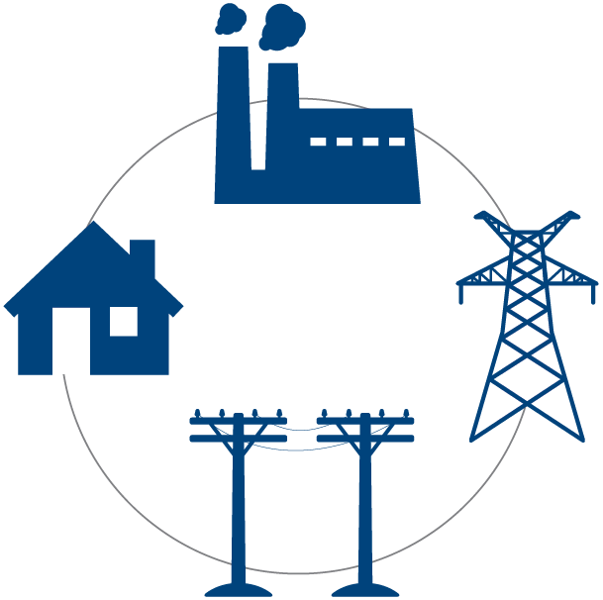
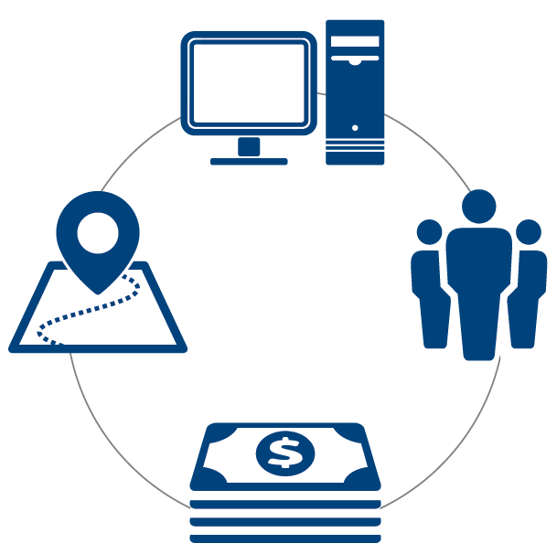
Power Sector Vulnerabilities
Infrastructure
System/ Process
Generation
Transmission
Distribution
Customer
Operations
Workforce
Planning
Financial

Slide 6
Power Sector Vulnerabilities
Vulnerabilities can also be categorized following the threats that may expose them.
Types of threats | Vulnerability examples
Physical | Lack of backup systems and supplies or single points of failure in transportation route, electrical line, water supply, or fiber optic cable.
Natural | Location prone to flooding, fire, etc.
Technological (Hardware, Software or Media) | Lack of cyber security defenses
Human | Poorly resourced or under-trained workforce
Others | Location-specific vulnerabilities identified by the resilience assessment team

Slide 7
Infrastructure Vulnerabilities

Slide 8
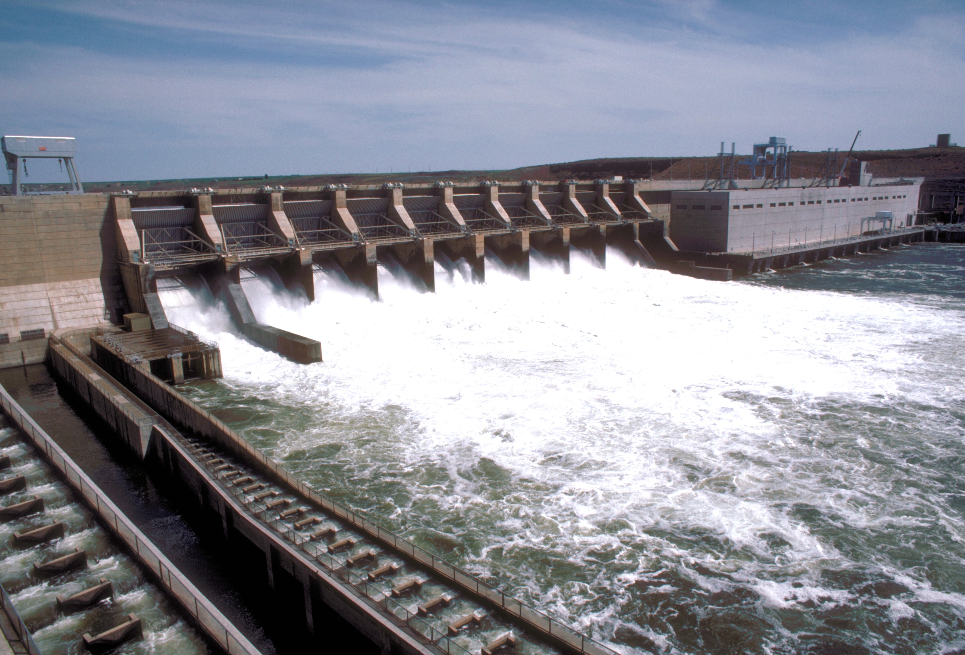
Generation
Aging infrastructure is more vulnerable to impacts from threats
Insufficient cooling water supply & changes in supply temperature
Fuel supply uncertainties
Water for hydro
Coal, gas, biomass
Undersized capacity for future needs
Restricted supply chain for parts and fuels
Photo: US Army Corps of Engineers.

Slide 9
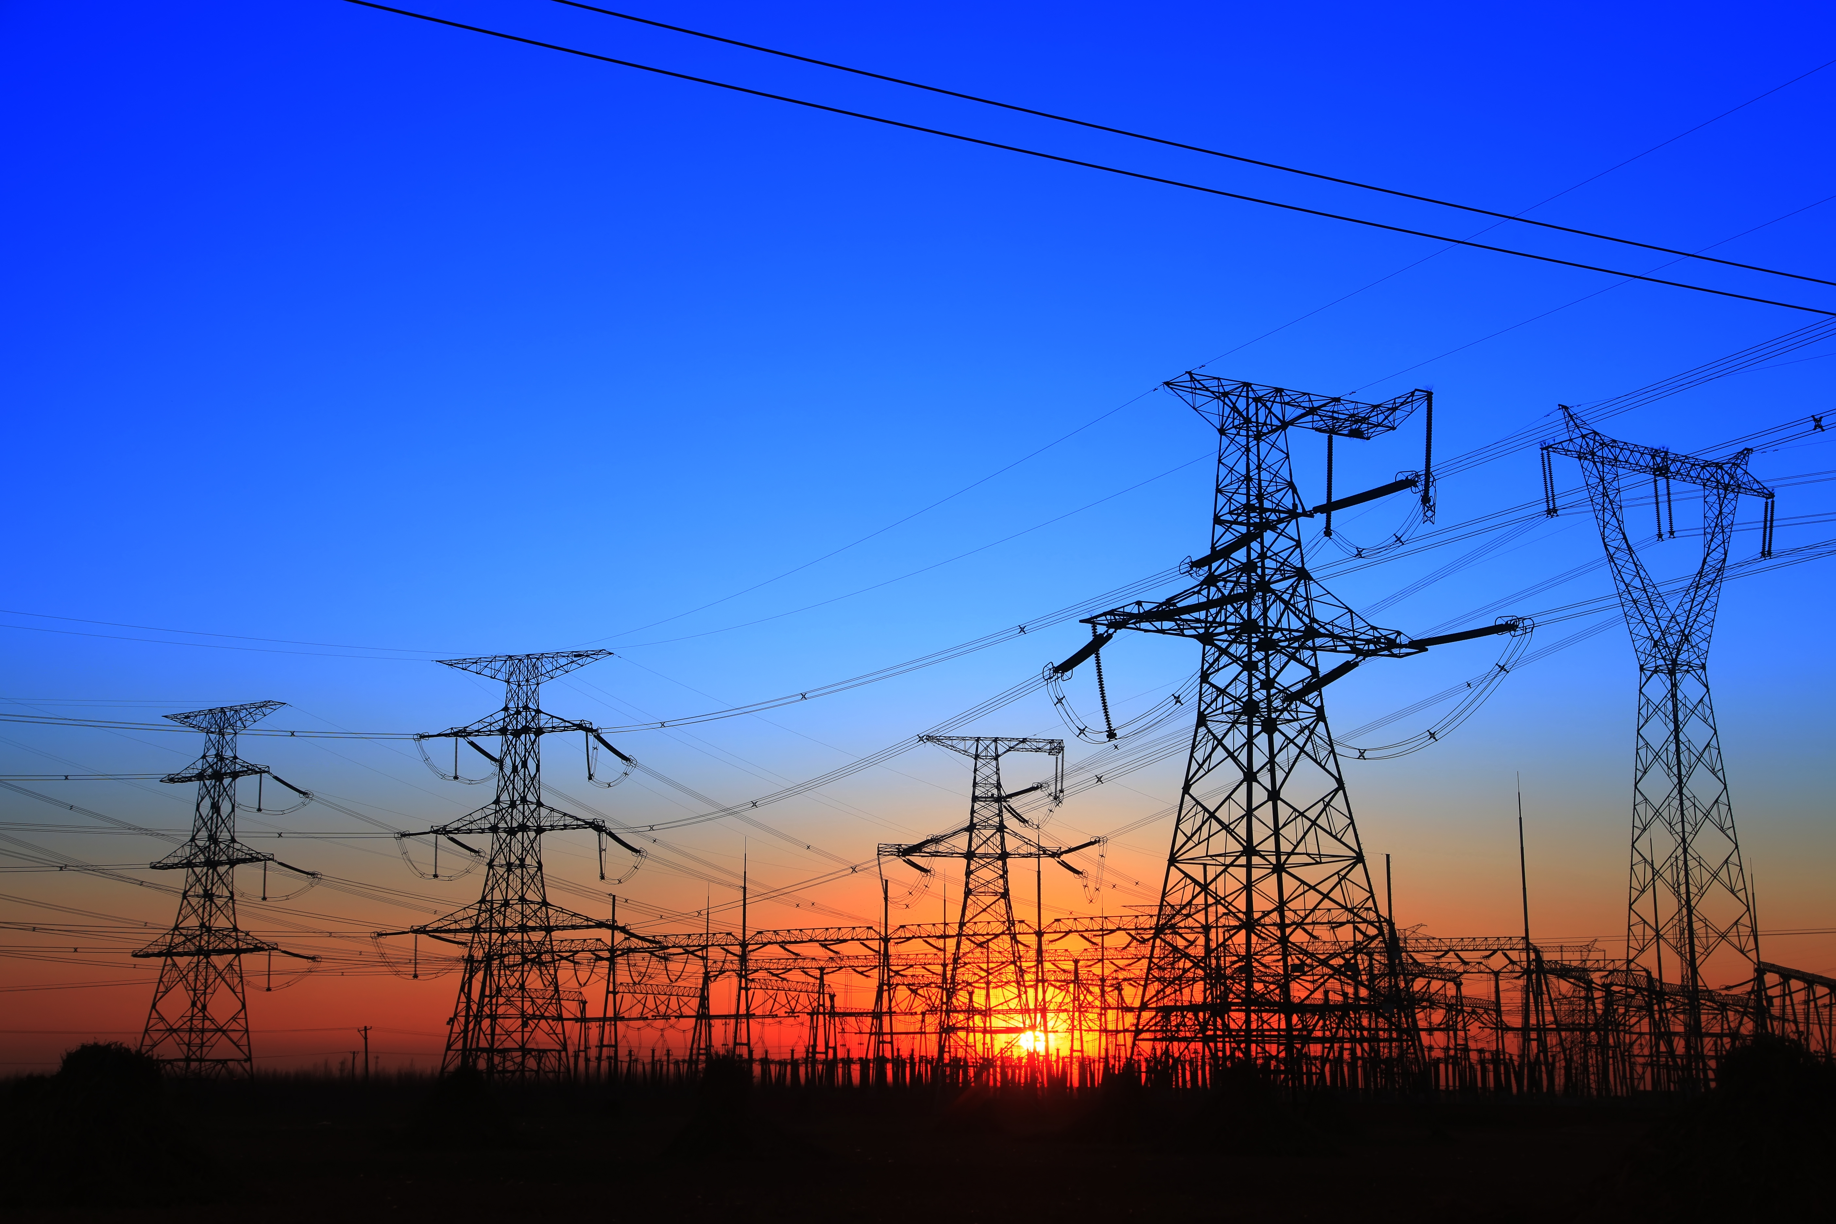
Transmission
Infrastructure design susceptible to failure
Aging infrastructure
Undersized power systems
Transmission bottlenecks
Lack of redundant lines
Restricted supply chain for parts and fuels
Exposed transmission & distribution lines in high wind & high threat environments
345 kV
Source: iStock

Slide 10
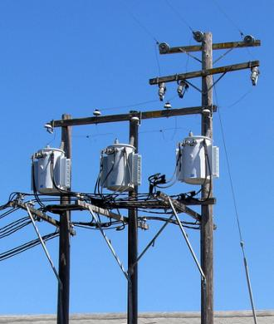
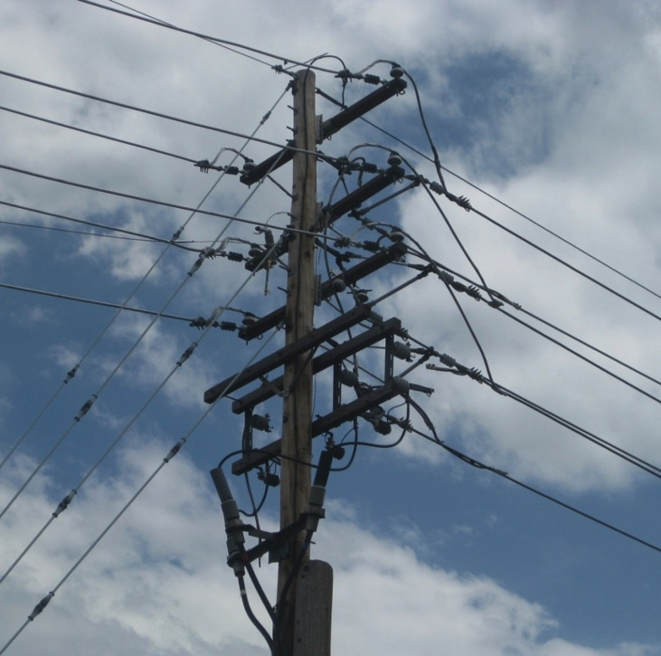
Distribution
Infrastructure design susceptible to failure
Infrastructure design susceptible to interference from people and wildlife
Vegetation interactions with distribution network, such as tree limbs contacting power lines
Aging infrastructure
Undersized power systems for rapid population growth
Other infrastructure can negatively impact power system
Lack of redundant power for critical loads
Restricted supply chain for parts and fuels
Poles not buried to adequate depth
Workforce capacity lacking in installation requirements for resilience
Photos courtesy Michael Coddington, NREL

Slide 11
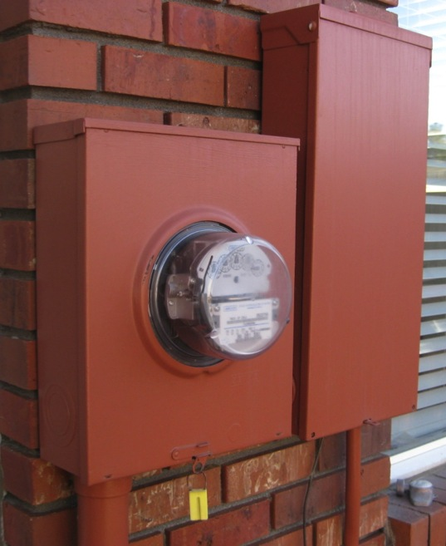
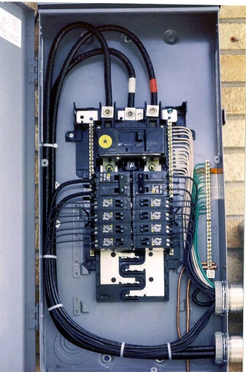
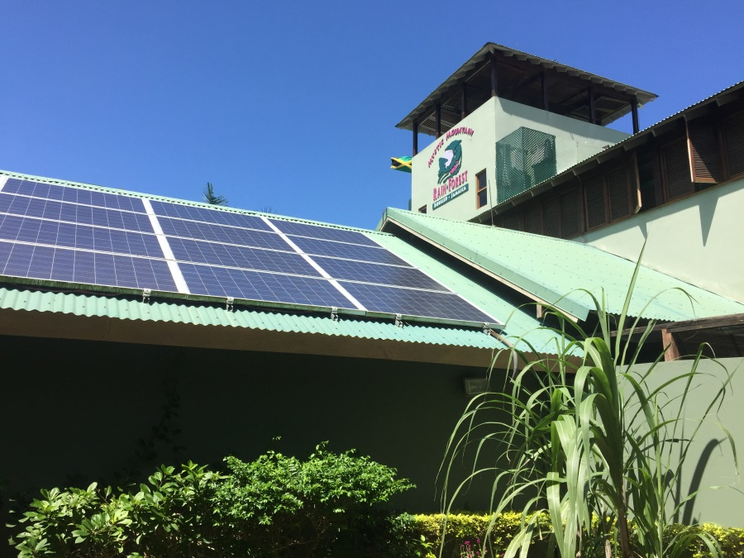
Customer (Demand)
Interference from non-compliant equipment
Unauthorized self-generation
Unpredictable loads
Informal/unauthorized connections (e.g., electricity theft/piracy)
Photos courtesy Michael Coddington and Sherry Stout, NREL

Slide 12
Process Vulnerabilities

Slide 13
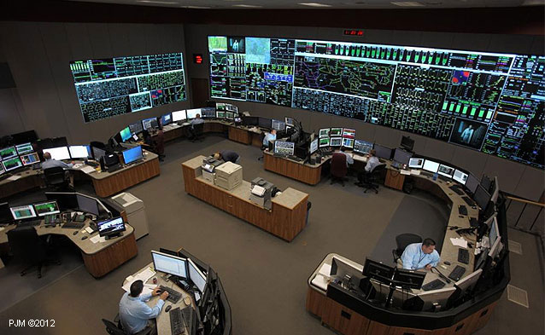
System Operations
Limited operational flexibility
Limited generation forecasting
Lack of UPS/backup power on operation centers
Lack of cyber and physical security measures
Lack of granular data on infrastructure and energy consumption/needs
Lag time in communications between system components
Figure. Siemens. Siemens platform managing North America’s largest transmission grid (PJM Regional Transmission Organization Control Room). Photo: PJM Interconnection https://w3.siemens.com/smartgrid/global/en/projects/pages/pjm.aspx

Slide 14
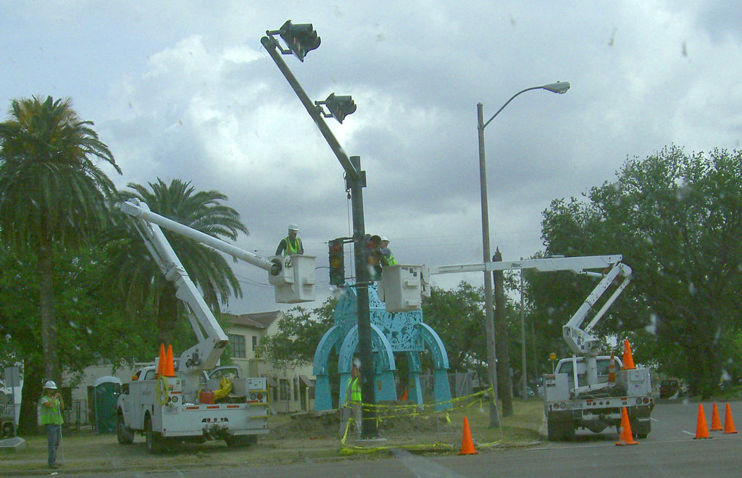
Workforce and Human Resources
Restricted supply chain across all operations
Under-resourced/trained workforce
Access time for workforce during emergency operations
Figure. "NOLA stoplight repair" by opacity is licensed under CC BY-NC-ND 2.0
Notes:
Image: Local utility needed to temporarily cut power to 250 homes in order to rescue the cat that had been stuck for 9 days.

Slide 15
Planning
Resilient design not included in broader planning (IRPP-Integrated Resource and Resilience Planning)
Inaccurate predictions for load growth
Generation needs
Destruction needs
Lack of updated codes/standards
Lack of short, mid, and long term plans for infrastructure upgrades
Lack of coordination with other government agencies
Lack of coordination and communication between power sector stakeholders
Lack of granular data on infrastructure and energy consumption/needs
Lack of formal agreements for emergency response with surrounding countries
Figure. Dennis Schroeder. NREL. 2010. NREL members and AIST (Advanced Industrial Science and Technology) members meet at SolarTAC in Aurora at the site of a concentrated solar PV system being tested by the joint partnership. Image #. 19109

Slide 16
Financial
Insufficient capital for system upgrades
Difficulty in securing financing for infrastructure projects
Lack of funding for workforce development
Low rates of customer bill collection
Heavy energy subsidies that are not recovered through rates

Slide 17
Discussion and Key Takeaways
What vulnerabilities do you think of when you consider your power sector?
Multiple vulnerabilities can impact the power sector. These usually fall into two categories:
Infrastructure
Process
Infrastructure vulnerabilities relate to the built environment.
Easier to fix, but more $$
Process vulnerabilities relate to human interactions with the power sector.
Less $$, more difficult

